Slide 1
INTRODUCTION TO PHOTOSYNTHESIS
NAME:

Slide 2
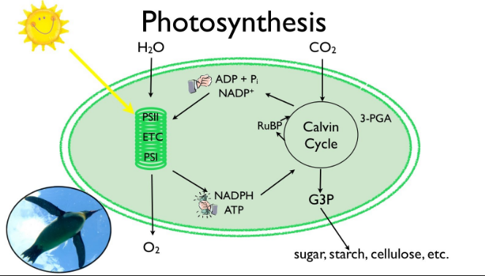
DEFINITION
Photosynthesis is a biological process by which plants, algae and cyanobacteria use light energy to synthesise chemical energy for use and growth and worn out tissues. The process occurs in chloroplast of the cell and use Caron (IV) Oxide and water to release energy and oxygen.
The process can be summarized using the following chemical equation;
6CO2+6H2O→C6H12O6+6O2.
The image is obtained from courses.lumenlearning.com/boundless-biology/chapter/overview-of-photosynthesis 6/15/18

Slide 3
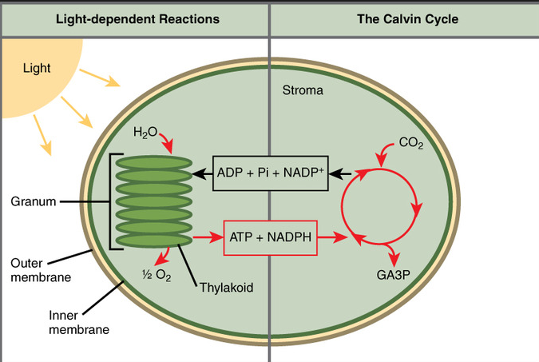
THE LIGHT DEPENDENT REACTIONS.
In light-dependent reactions, chlorophyll in the leaves absorbs sunlight and is converted into ATP (adenosine triphosphate) and NADPH (nicotinamide adenine dinucleotide phosphate) which are electron carrier molecules. The light- dependent reactions occur in the thylakoid membranes inside the granum of the chloroplast.

Slide 4
THE LIGHT INDEPENDENT REACTIONS.
It is also called the Calvin Cycle because the reactions in this stage happens in a cyclical nature. ATP and NADPH formed in the light-dependent reactions supply the energy for this stage. The end product of this reaction is carbohydrates which are formed from carbon dioxide molecules.
The light-independent reactions occurs without using light as a reactant, however, they utilise products synthesised in the light-dependent reactions to proceed. This stage uses the energy carrier molecules, ATP and NADPH, to facilitate the formation of more carbohydrate molecules. After the reactions in this stage are completed, the energy carrier molecules ATP and NADPH goes back to the light-dependent reactions to gain more energized electrons

Slide 5
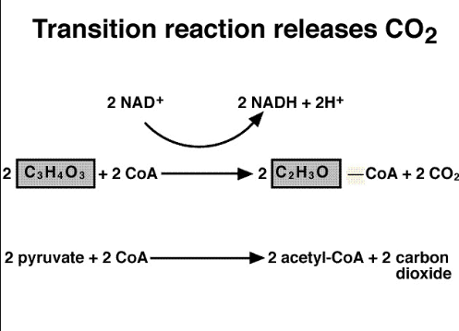
THE TRANSITION BETWEEN PHOTOSYNTHESIS AND RESPIRATION
Carbon atoms do not change during the transition of photosynthesis and respiration. 12 three carbon molecules are synthesised for every six carbon (IV) oxides molecules that get into the cycle.
The three-carbon molecules then enter a series of chemical reactions and breakdown. In every twelve three-carbon molecules used in the reaction, two carbon molecules are broken down to build organic components.

Slide 6
CELLULAR RESPIRATION
Cellular respiration is a set of metabolic reactions and processes that take place in the cells of organisms to convert biochemical energy from nutrients into adenosine triphosphate (ATP). It occurs in the four stages as follows;
Glycolysis; In this step a glucose molecule undergoes a series of chemical reactions and get converted into two pyruvate molecules.
Pyruvate oxidation; Every pyruvate molecule from glycolysis step enters the mitochondrial matrix and get converted into acetyl CoA which is a two-carbon molecule bound to Coenzyme A.
Citric acid cycle; The acetyl CoA made pyruvate oxidation combines with a four-carbon molecule and proceed to a series of reactions resulting in the formation of a four-carbon starting molecule and ATP.
Oxidative phosphorylation; The movement of electrons down the chain releases energy is released which is used to pump protons out of the reaction matrix, creating a gradient. Protons will the cycle back into the matrix using ATP synthase, forming ATP.

